Slide 1
Matrix Factorization

Slide 2
Why Matrix Factorization
Dimension reduction for recommender algorithm
Find latent factors in the data
Latent because they’re defined by something that an algorithm calculates
It will not make sense to humans
They are trends in the data that show or explain the user’s taste
Invented by Simon Funk during Netflix competition
Find latent factors for ratings matrix

Slide 3
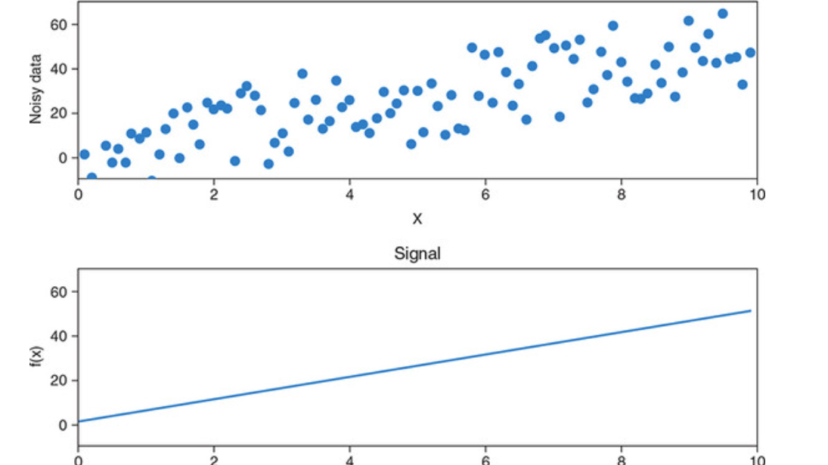
Notes:
“Think about the data as a cloud of points, and you want to project the data into a lower-dimensional space where the distance between the objects is the same. Then the points that were further from each other before the reduction are also further away after the reduction, and nearby items are also closer after the reduction. You want to reduce the data so that only the directions that provide more information are retained. If the algorithm succeeds, then the vectors pointing in those directions are said to be latent factors.”

Slide 4
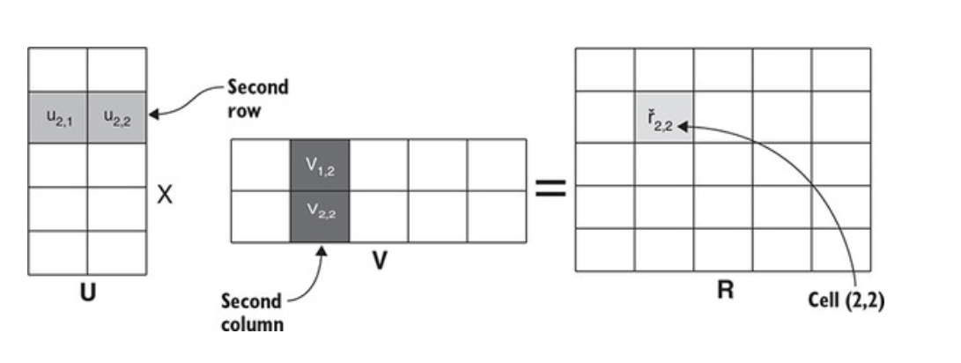
Matrix Multiplication

Slide 5
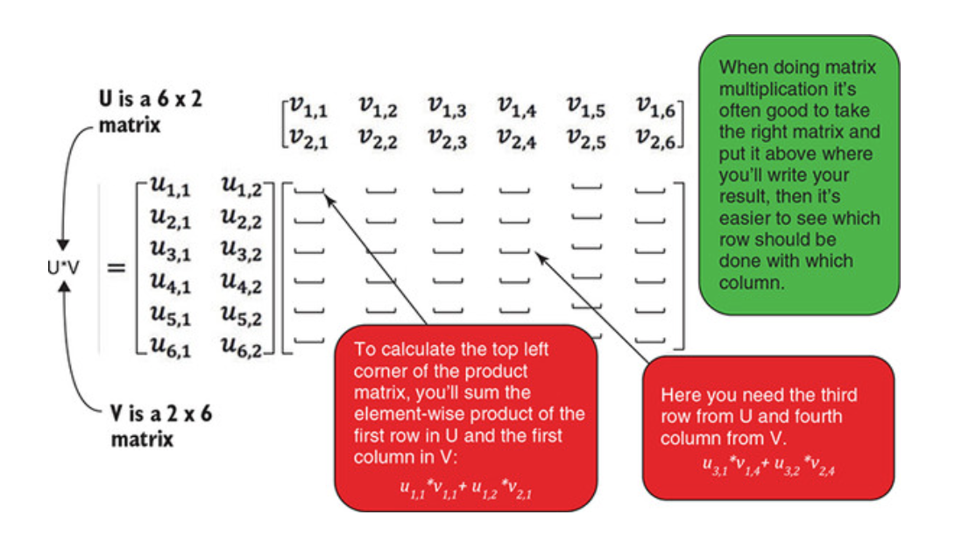
Matrix Multiplication

Slide 6
Factoring the Matrix
Splitting the matrix
100 = 2 x 2 x 5 x 5
Factor a matrix into a product of matrices
Rating Matrix = UV

Slide 7
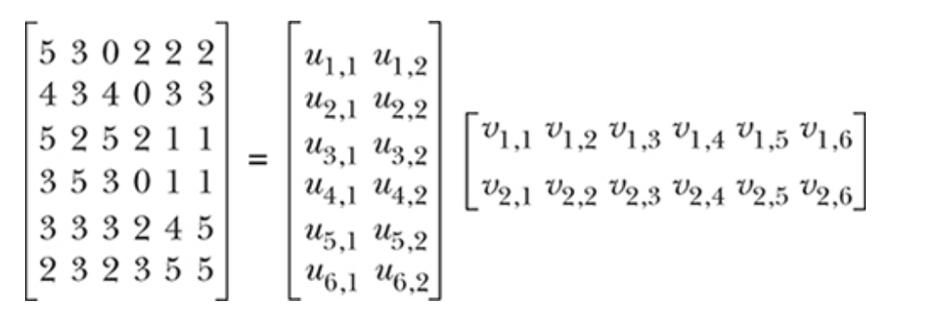
UV Decomposition with 2 Dimensions
Rating Matrix (R) dimensions = Users x Items
R = UV
User feature matrix (U) = Userx x Dimension (D)
Item feature matrix (V) = Dimension (D) x Items

Slide 8
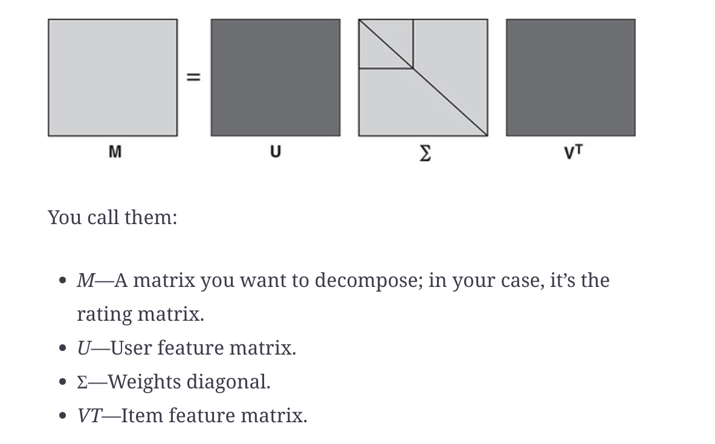
Factorization using SVD

Slide 9
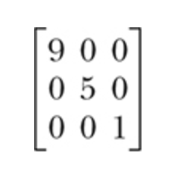
Diagonal Matrix
It has zeros except in the diagonal
Central diagonal matrix contains elements that are sorted from the largest to smallest
The elements are called singular values and they indicate how much value this feature produces for the data set

Slide 10
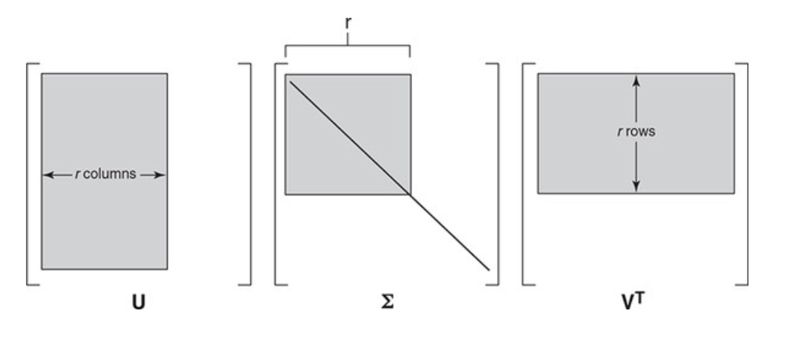
Setting unimportant singular values to Zero

Slide 11
Demo - Matrix Factorization Notebook

Slide 12
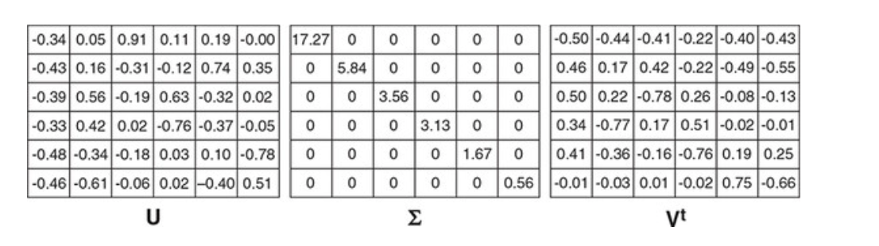

Slide 13
How much should the matrix be reduced
Rule of thumb - Retain 90% of the information

Slide 14
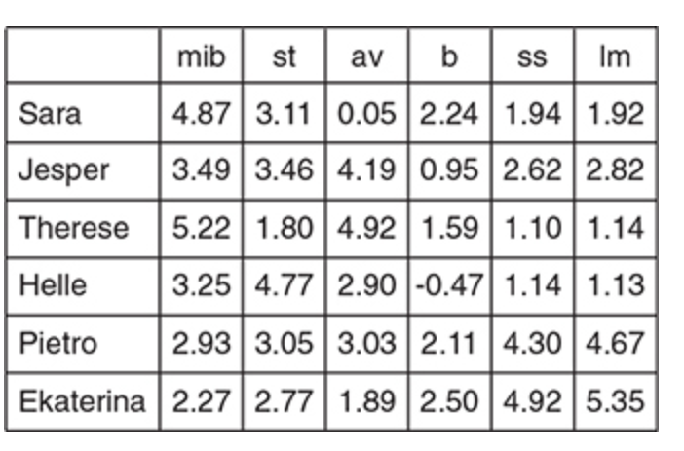
Predicting a rating

Slide 15
Demo - Notebook Calculation for reduced matrix

Slide 16
Rating Matrix Imputation
Only a few cells in the rating matrix will have values
Mean imputation for the User or Item
Normalize each row centered on zero

Slide 17
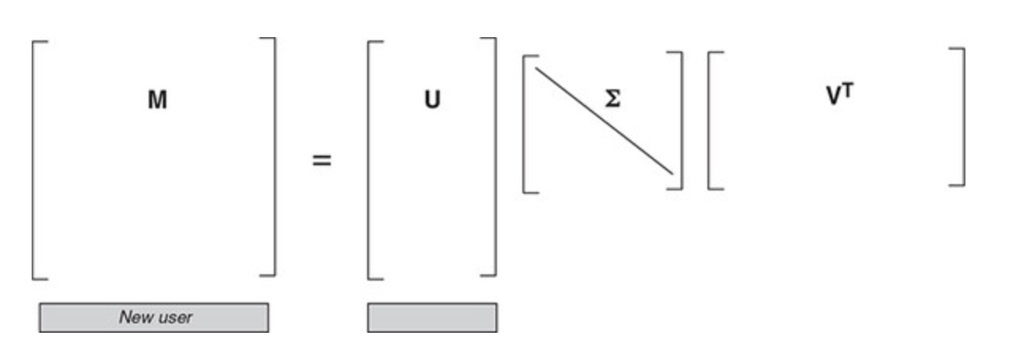
Adding a New User or Item
Users and Items can be added (though not before there have been interactions)

Slide 18
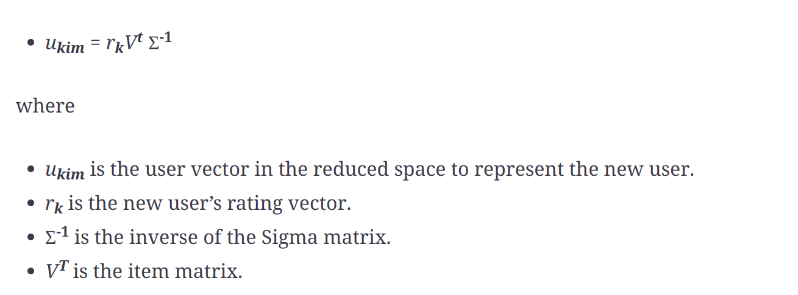
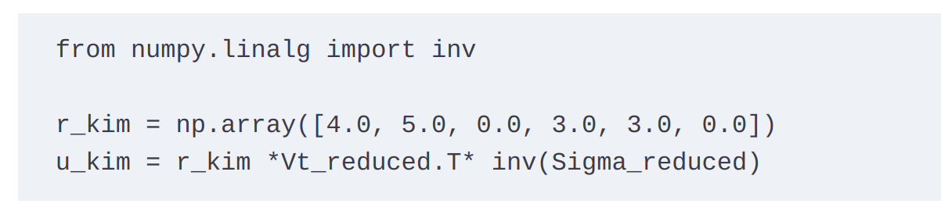

Slide 19
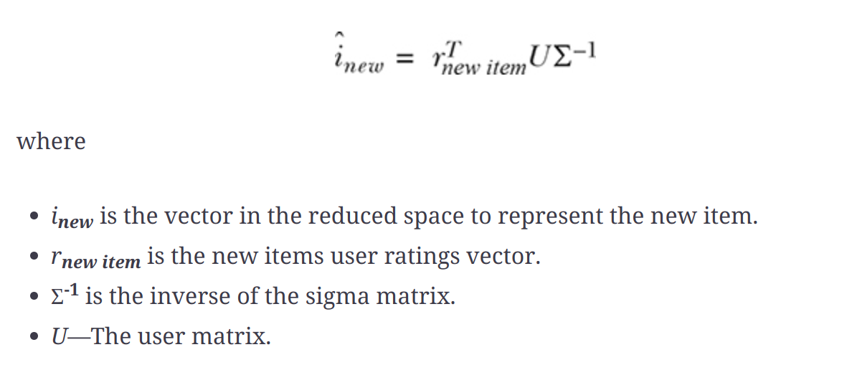
Adding New Items

Slide 20
Why should we update SVD when we are able to add users and items?

Slide 21
Updating SVD
Latent factors are not updated when we add users and items
Update it depending on the number of new users or items

Slide 22
Challenges with SVD
It needs imputation with unfilled cells
Slow to calculate large matrices
SVD should be updated as often as possible
SVD isn’t at all explainable

Slide 23
